Slide 1

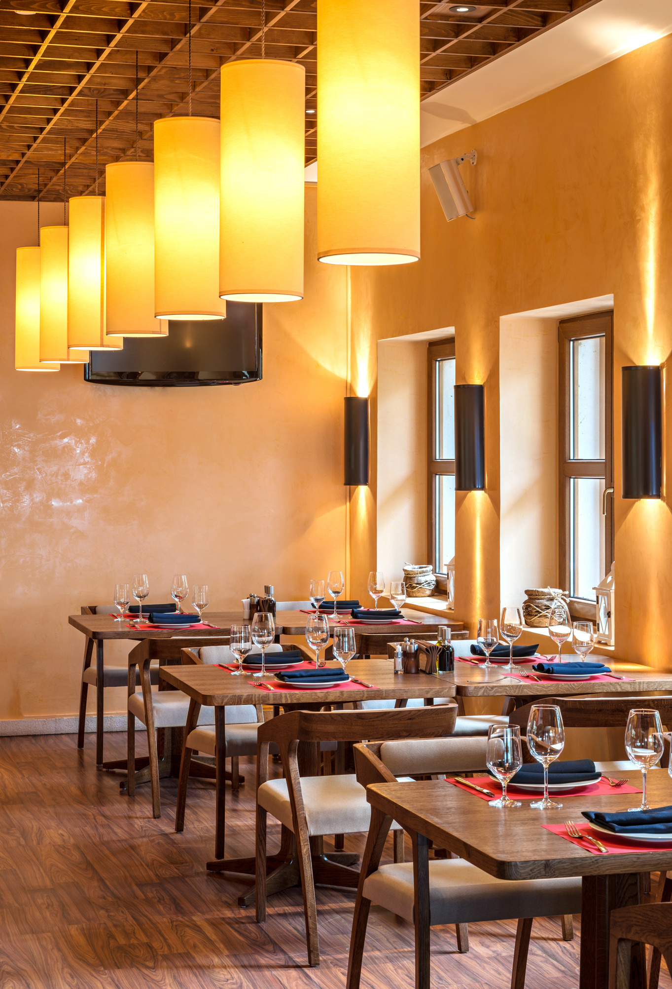


European restaurants
Bigger Then Data (BTD)
Afnan Alzahrani
Amjad Almusallam
Abdullah Alhuwaishel
Jumana Almussa
Mahmoud Alhassan

Slide 2

01
Data Review
European restaurants
TripAdvisor European restaurants dataset from Kaggle, It consists of 1083397 rows and 42 Columns
Columns:
Restaurant_name , country, original_location, city, original_location
latitude, longitude, claimed, price_level, meals, cuisines, vegetarian_friendly, vegan_options, gluten_free, open_days_per_week, original_open_hours, open_hours_per_week, working_shifts_per_week, original_open_hours, avg_rating
total_reviews_count, default_language , reviews_count_in_default_language
food, service, value

Slide 3
European restaurants
08
Data Preparation
Preprocessing

Slide 4
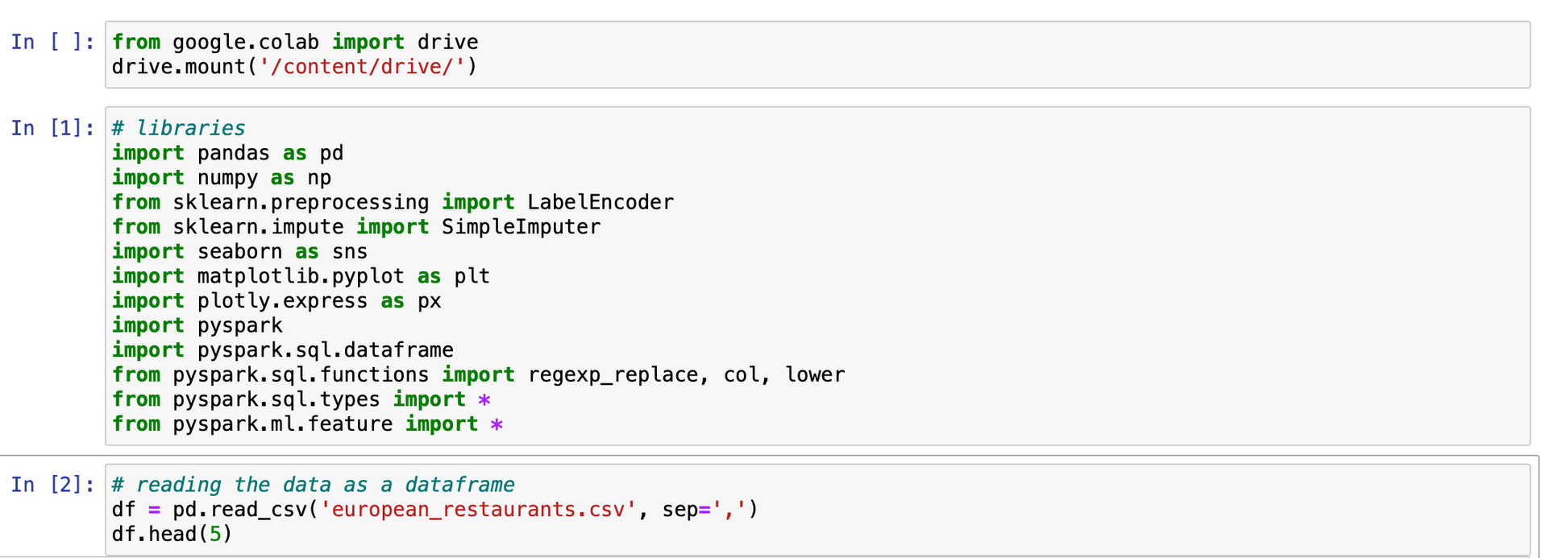
Data Preparation
xxxxx
European restaurants

Slide 5
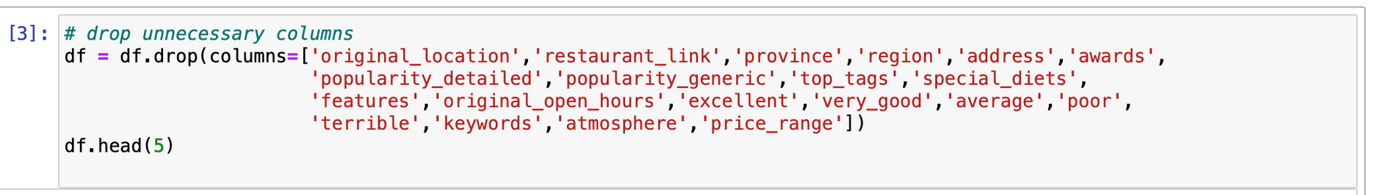
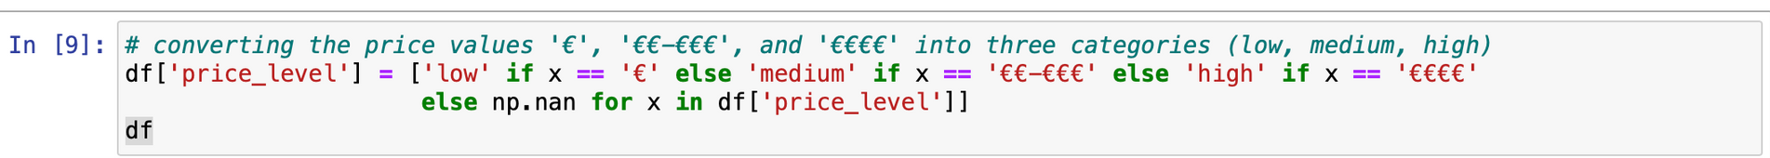
Preprocessing
European restaurants

Slide 6
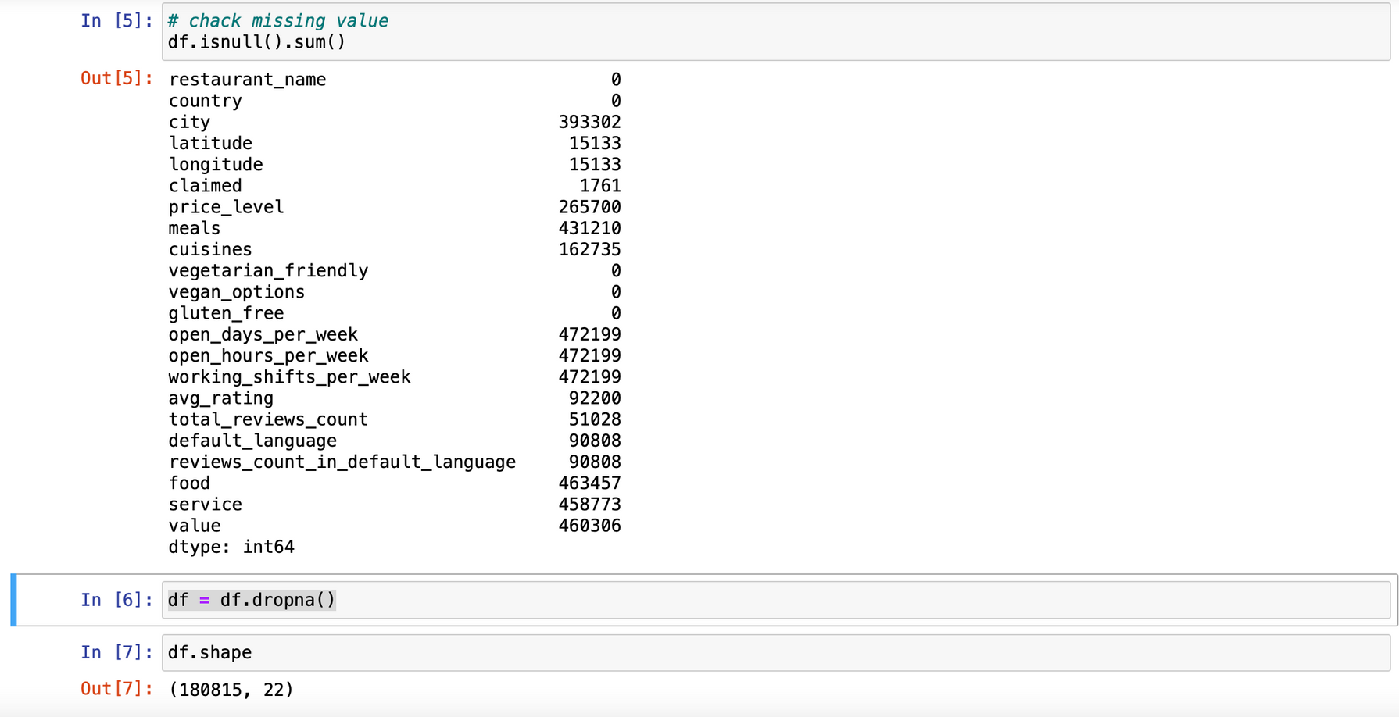
Preprocessing
European restaurants

Slide 7
European restaurants
08
EDA

Slide 8
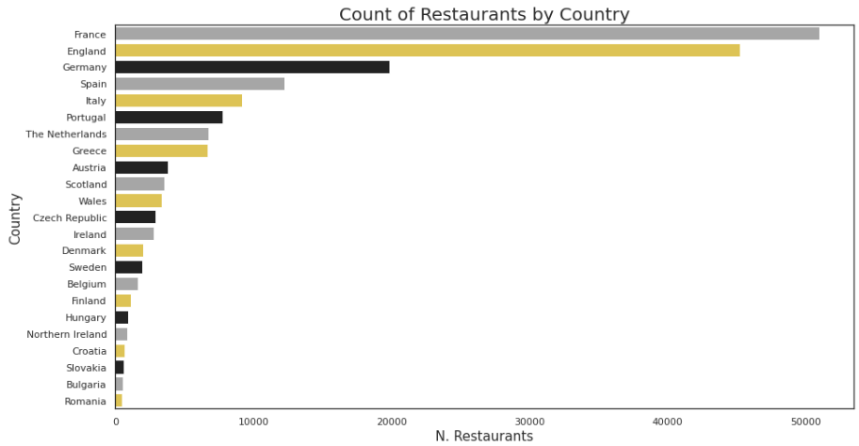
xxxxx
European restaurants

Slide 9
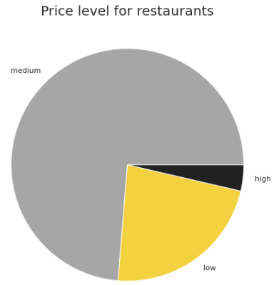
xxxxx
European restaurants

Slide 10
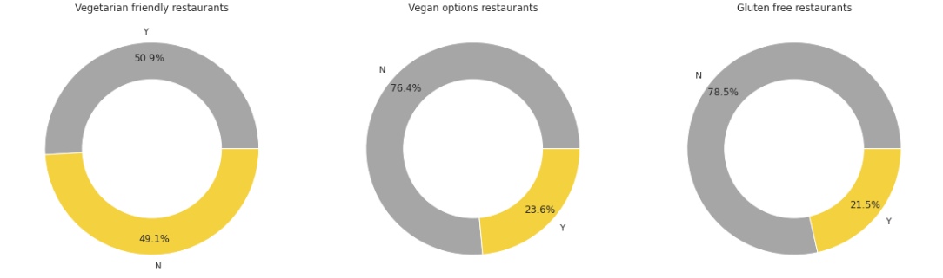
xxxxx
European restaurants

Slide 11
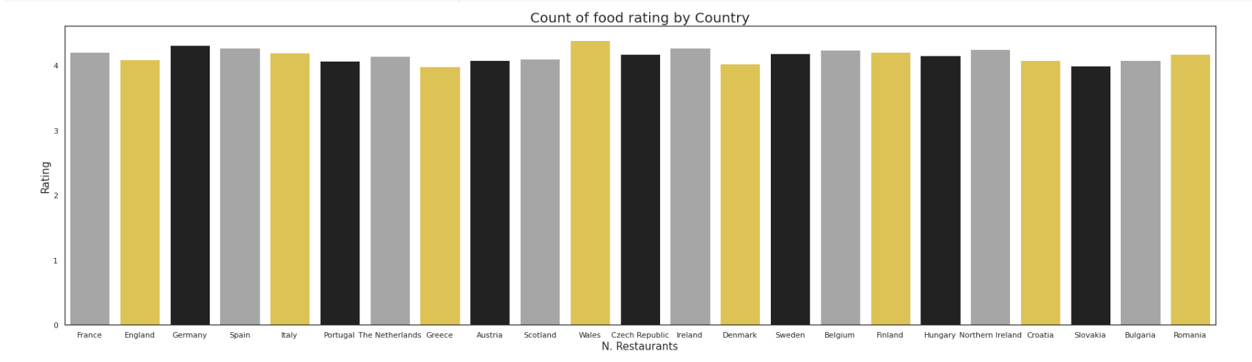
xxxxx
European restaurants

Slide 12
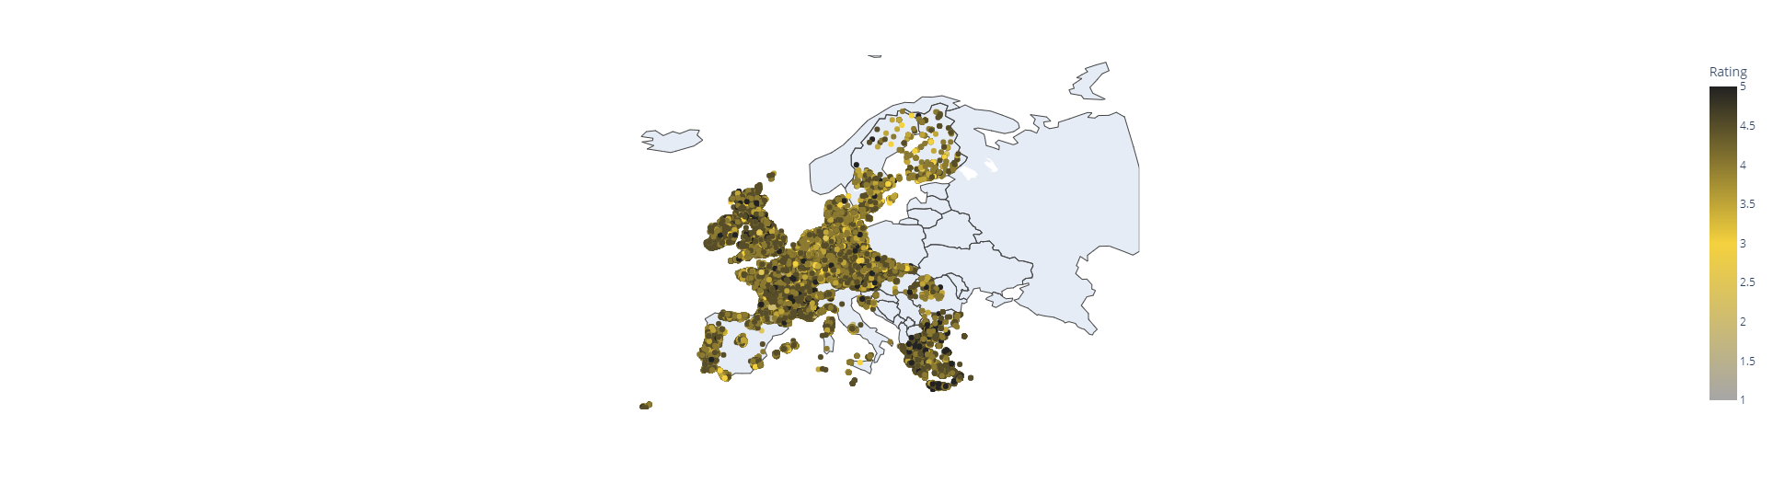
xxxxx
European restaurants

Slide 13
European restaurants
08
Data Processing

Slide 14
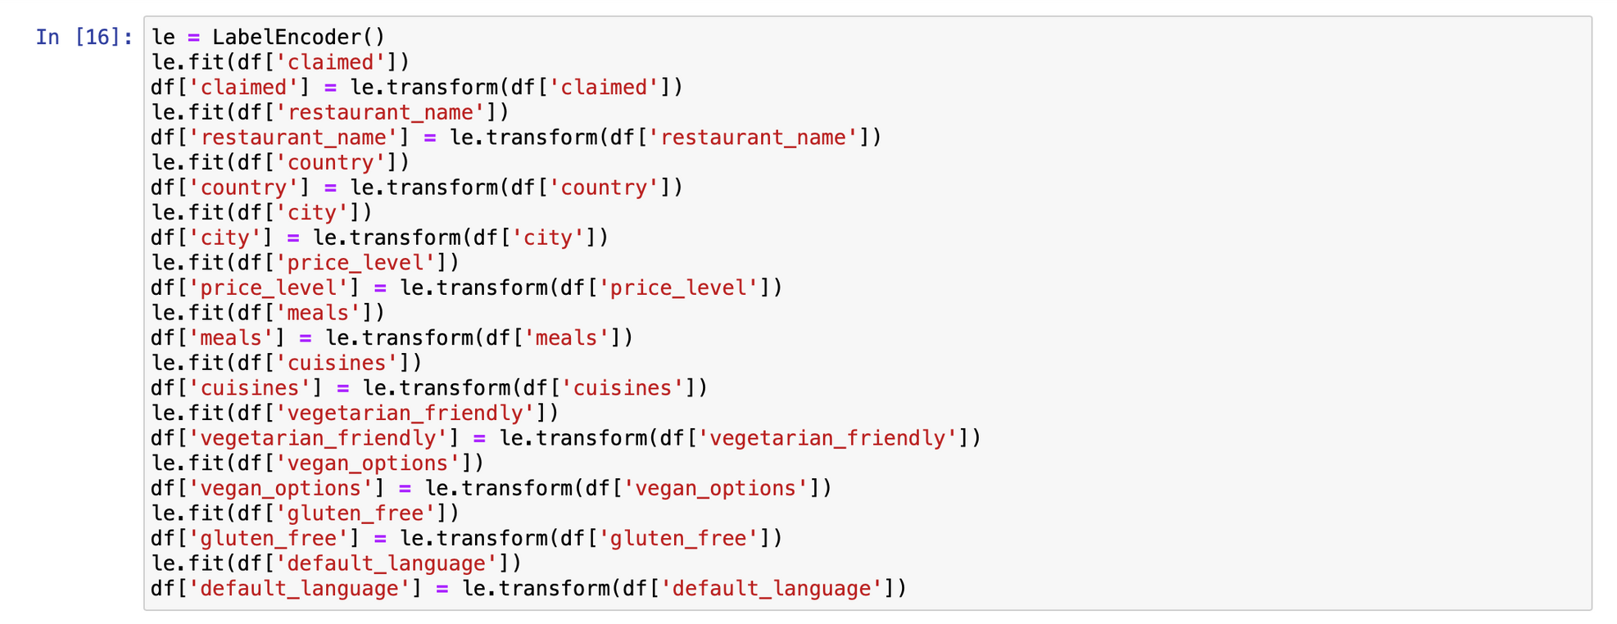
Data Processing
European restaurants

Slide 15
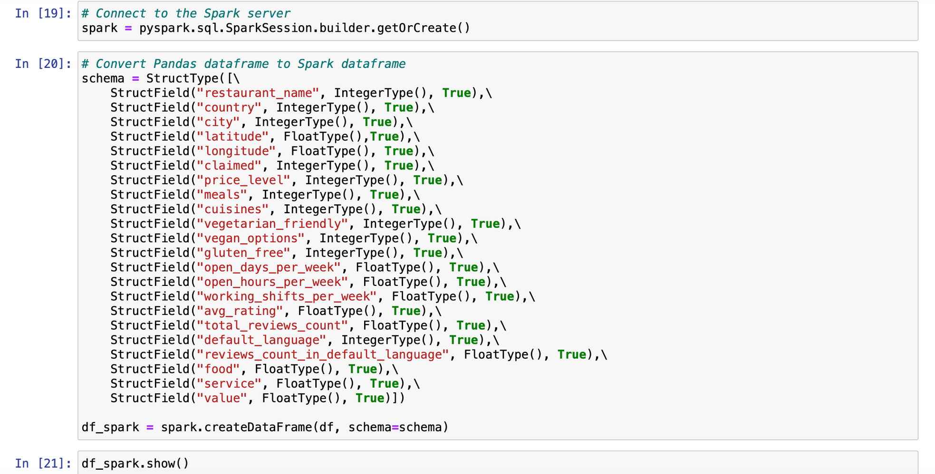
Data Processing
European restaurants

Slide 16
European restaurants
08
Building a Model

Slide 17
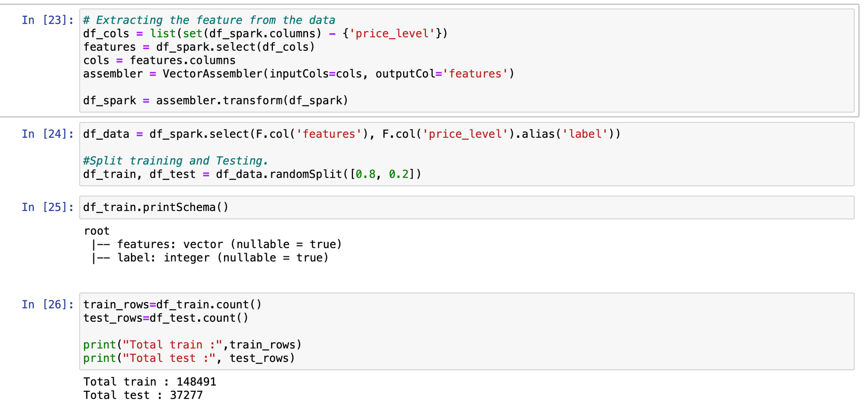
Building a Model
Splitting data into training and testing sets
European restaurants

Slide 18
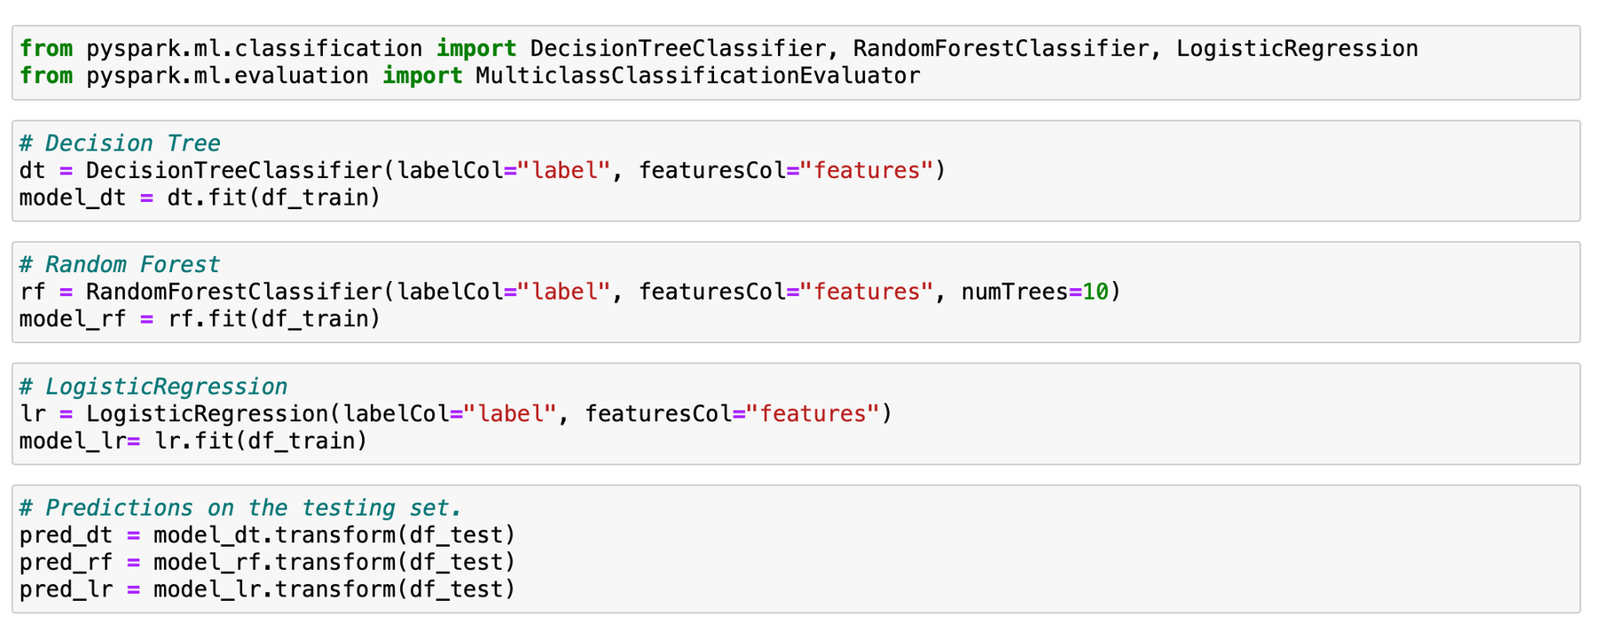
Building a Model
Machine learning algorithms
European restaurants

Slide 19
European restaurants
08
Model Evaluation

Slide 20
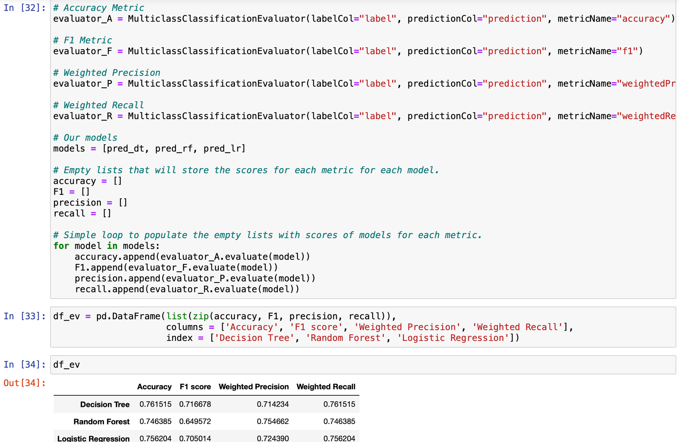
European restaurants

Slide 21

European restaurants
07
Thank you

